Slide 1
St. Cloud State University
圣克劳德大学

Slide 2
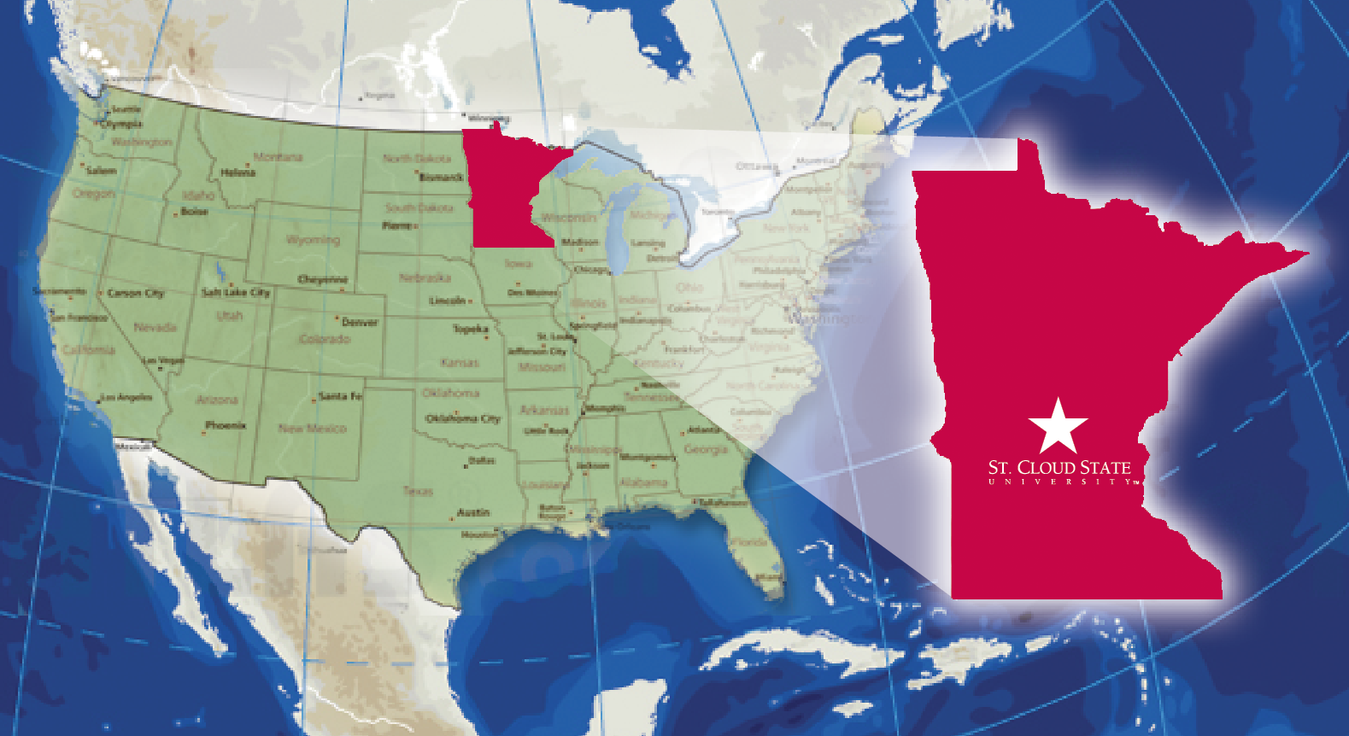
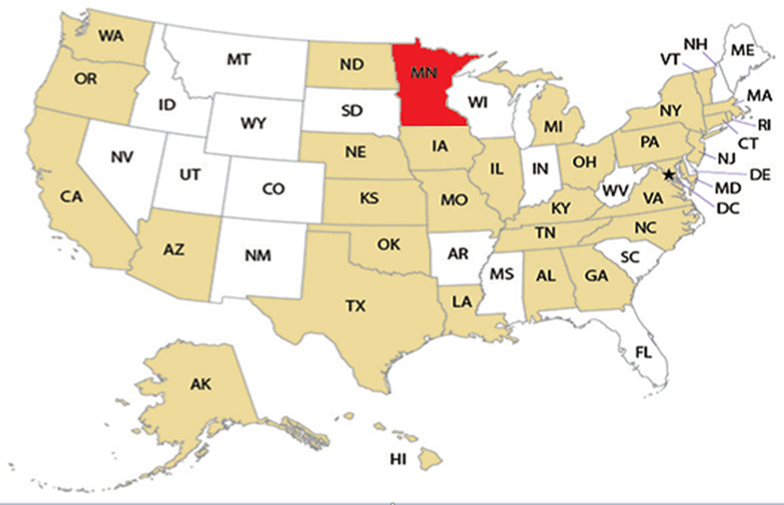
St. Cloud State University
St. Cloud, Minnesota
明尼苏达 圣克劳德大学

Slide 3
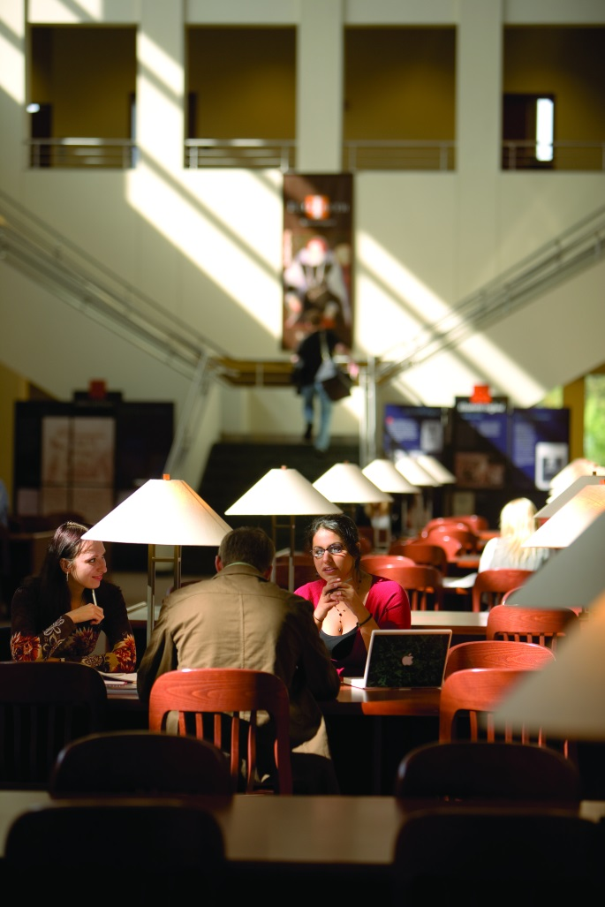
Highlights亮点
St Cloud State is the second largest University in Minnesota
圣克劳德大学是明尼苏达州第二大公立大学
It is located on 100 acres
along the banks of the Mississippi River
位于距密西西比河岸100英亩处
SCSU is located in central Minnesota with a population
of approximately 100,000
学校位于明尼苏达州中心，人口约100,000

Slide 4
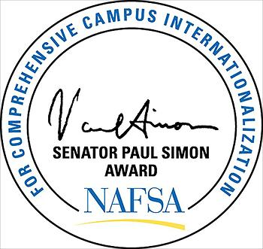


St. Cloud State Rankings and Awards排名/荣誉
St. Cloud State is recognized nationally with the 2013 Simon ward for its excellence in integrating international education across all aspects of the university.学校因在国际化教学中各学科出色的教育成果获得2013西蒙奖
U.S News & World Report’s 2012 best colleges listings ranked St. Cloud State 10th among regional universities for its number of international student
学校因国际学生数目在区域大学中2012排名2012美国排名中列为第十名
St. Cloud State has been recognized as an innovator in international higher education with the Institute of International Education's (IIE) 2013 Andrew Heiskell Award.
该校被认可国际高等教育中的革新者，并获得海斯科尔奖
2013 Simon Award
U.S News & World Report’s 2012
2013 Andrew Heiskell Award

Slide 5
SCSU Statistics数据
Over 16,000 students currently enrolled
学生总人数超过16,000
Offer over 200 undergraduate majors, minors and pre-professional programs.
有200个本科专业，辅修专业和职业教育课程
Our student to faculty ratio is 23:1, with an average class size of 27 students
师生比率23:1. 平均班级规模27人
Student have access to over 700 computers across campus, along with free wi-fi campus-wide
超过700台电脑供学生使用，并配有全校覆盖的免费无线

Slide 6

Academic Quality
SCSU offers an applied career instruction and theory behind application.学校提供应用职业指导及理论
Accreditation
Higher Learning Commission
高等教育委员会
Member, North Central Association of Colleges & Schools成员，中北部大学及学院协会
The University also actively seeks and receives recognition for its individual academic programs
from other accrediting bodies.

Slide 7
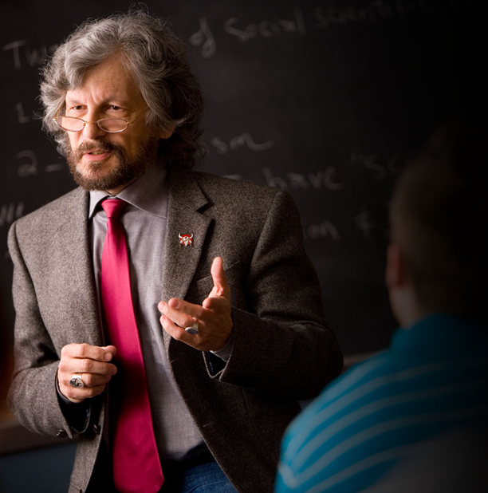
Teaching First教育为先
93 % of classes are taught
by professors93%的班级由教授亲自授课
Students receive personalized attention from professors with our small class sizes小班规模给与学生更多关注
Opportunities for personal research and exploration for undergraduate students 给本科学生提供学科探索研究的机会

Slide 8

Discover Diversity
We strive to prepare students for careers in the global marketplace我们努力为学生创造国际化工作平台
Currently SCSU has over a 1,000 international students from more than 80 countries 目前学校有来自于80所国家超过1000名国际学生
See the World! SCSU offers 32 study abroad programs all over the world 放眼世界：学校提供全球32项海外项目研究。

Slide 9

Student Success学生成就
Student Support Services
Academic Learning Center 学术学习中心
Advising Center咨询中心
Career Services 就业服务中心
Counseling & Psychological Services
心理咨询服务
Center for International Studies
国际学生中心
English as Second Language Classes
ESL语言中心
Health Services 健康服务中心
Intensive English Center (IEC)
英语强化中心
Multicultural Student Services
多元文化学生服务中心
Tutoring Center导师辅导中心
Writing Center 写作辅导中心

Slide 10
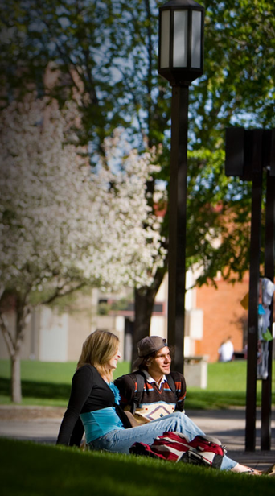
Student Life
Your personal & academic success is supported at SCSU学校支持你个人和学术发展
Residence Halls: provides a convenient location to campus, a sense of community, an affordable living environment, and different housing options to choose学生宿舍：位置便利，社区意识，价格合理，多重选择
Public Safety: supports personal & property safety through crime prevention and enforces the University code of conduct and parking regulations公共安全：防止犯罪偷到，保护个人财产安全，加强行为规范及停车规则
Student Involvement: offers more than 250 student clubs & organizations to develop leadership skills, network, and socialize!学生参与：超过250个学生社团和组织以锻炼领导精神

Slide 11
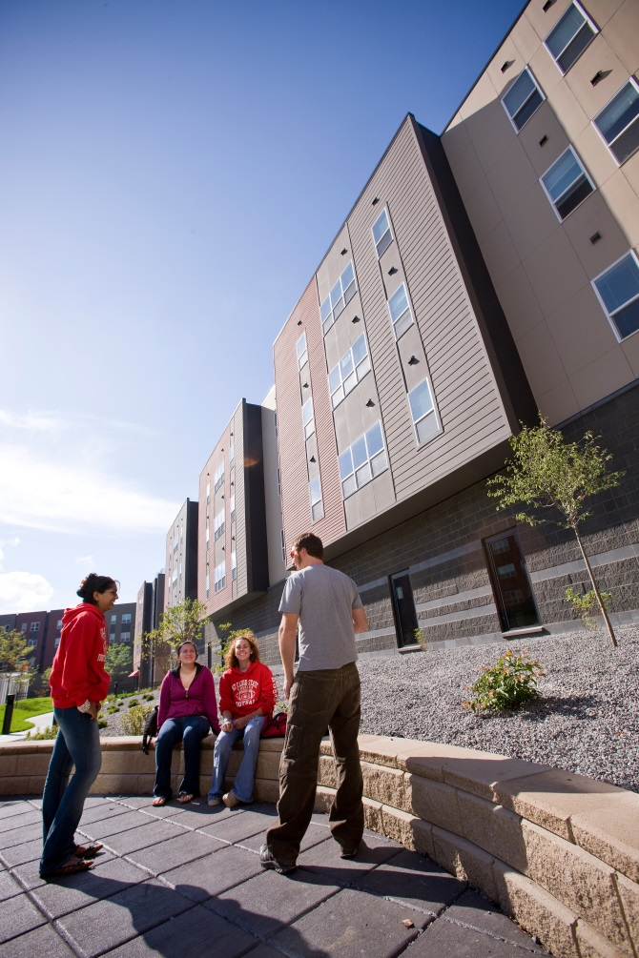
Facilities校园设施
Take a Virtual Tour of campus:
http://www.stcloudstate.edu/virtualtour/default.asp
On-campus housing and dining住宿和餐饮
Library, research, and computer labs图书馆，研究，和计算机实验室
ISELF – Integrated Science and Engineering
Laboratory Facility综合科学与工程实验室
Smart classrooms and lab spaces智能教室和实验室
Art studios, on-campus music halls and theater艺术工作室，校园音乐厅和剧院
Atwood Memorial Center – student organizations, student services, dining facilities阿特伍德纪念中心–学生组织，学生服务，餐饮设施
Athletic facilities for sports and recreation体育和娱乐体育设施
Bookstore and computer stores书店和电脑商店
Coffee shops and meeting spaces for individual and group study咖啡店、个人学习和小组讨论的会议室

Slide 12
International Undergraduate
Admission Requirements国际本科录取要求
Apply Online 网上申请
Submit a $20 non-refundable application fee交20美元的申请费：不退还
Provide required transcript and transcript evaluation
提供成绩单和成绩单评估报告
Provide proof of English proficiency
提供英语能力测试成绩（托福or雅思， SAT等）
Proof of student’s ability to cover his/her first year of educational expenses 提供存款证明
Specifics located at: http://www.stcloudstate.edu/internationaladmissions/apply.aspx

Slide 13
English Proficiency
TOEFL iBT of 61 with sub-scores of 15 in reading/writing/listening
托福 阅读写作听力不低于15分
IELTS of 5.5 雅思5.5
Transfer from an English-medium college with 2.5+大学转学需要GPA2.5以上
Graduation from an English-medium high school
在英语高中的中学学习，毕业

Slide 14
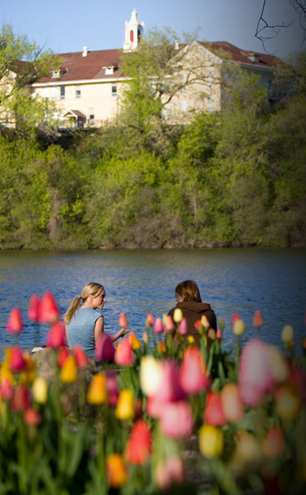
International Undergraduate
Financial Requirements 国际本科生经济要求
Tuition & Fees 学费 $12,603
Living Expenses 生活费 $11,404
Health Insurance 健康保险 $1062
Academic and Cultural Sharing学术文化交流奖学金
Scholarship (UG) -$6,298
Total w/ Scholarship (UG) $18,771
奖学金
UG tuition is frozen for two years.UG学费冻结两年
Estimated Cost

Slide 15
Affordability经济上可以负担
Academic and Cultural Sharing Scholarship学术文化共享奖学金(ACSS)
Provides in-state or resident tuition rate to international students给国际学生提供学费
Students must meet certain eligibility requirements学生必须符合资格要求
Scholarship promotes interaction and
cross-cultural understanding奖学金促进跨文化交流互动
Students on an F-I or J-I visa are eligible持F-1或J-1签证的学生有资格

Slide 16

Academic and Cultural Sharing
Scholarship Requirements学术文化共享
Check-in with the Center for International Studies upon arrival in the U.S.到学习国际学生中心报道到
Maintain a 2.5 CGPA as
an undergraduate GPA平均成绩2.5以上
Complete two cultural activities each semester每学期完成2项跨文化交流活动
Maintain active F-1/J-1 status持有 F-1/J-1 签证有效期

Slide 17
Why St. Cloud State University?为何选圣克劳德大学
Ideal location完美地理位置
Active campus life 积极的校园生活
Academic & personal support for student success学生学术和个人成功有保障
Facilities geared for the 21st century设备先进
A smart investment in a global education

Slide 18
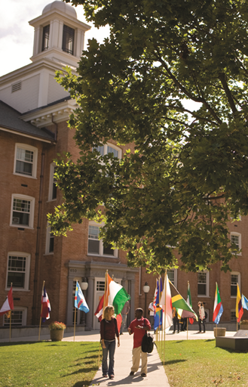
Contact Information
Center for International Studies
720 Fourth Avenue South
Lawrence Hall 101
St. Cloud, MN 56301 USA
国际研究中心
美国圣克劳德 劳伦斯大厅 101 南第四大街720号
Email: world2scsu@stcloudstate.edu
www.stcloudstate.edu

Slide 19



Notes:
Welcome to St. Cloud State University!

